Slide 1
Today
Videos - 2nd and 3rd “Climate Emergency: Feedback Loops”
How the terrestrial and ice-albedo feedbacks could be implemented in Cambio ("Level 2” and “Level 3")
More ideas for your projects
Week_11c.ClimateSensitivity: Calculating climate sensitivities in models

Slide 2
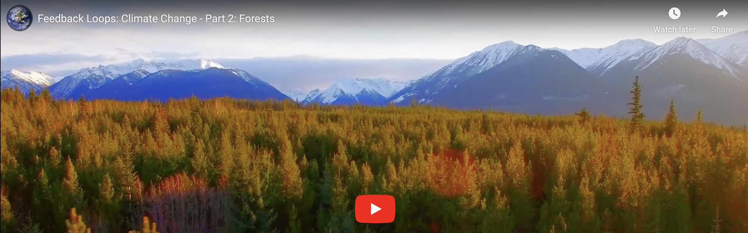
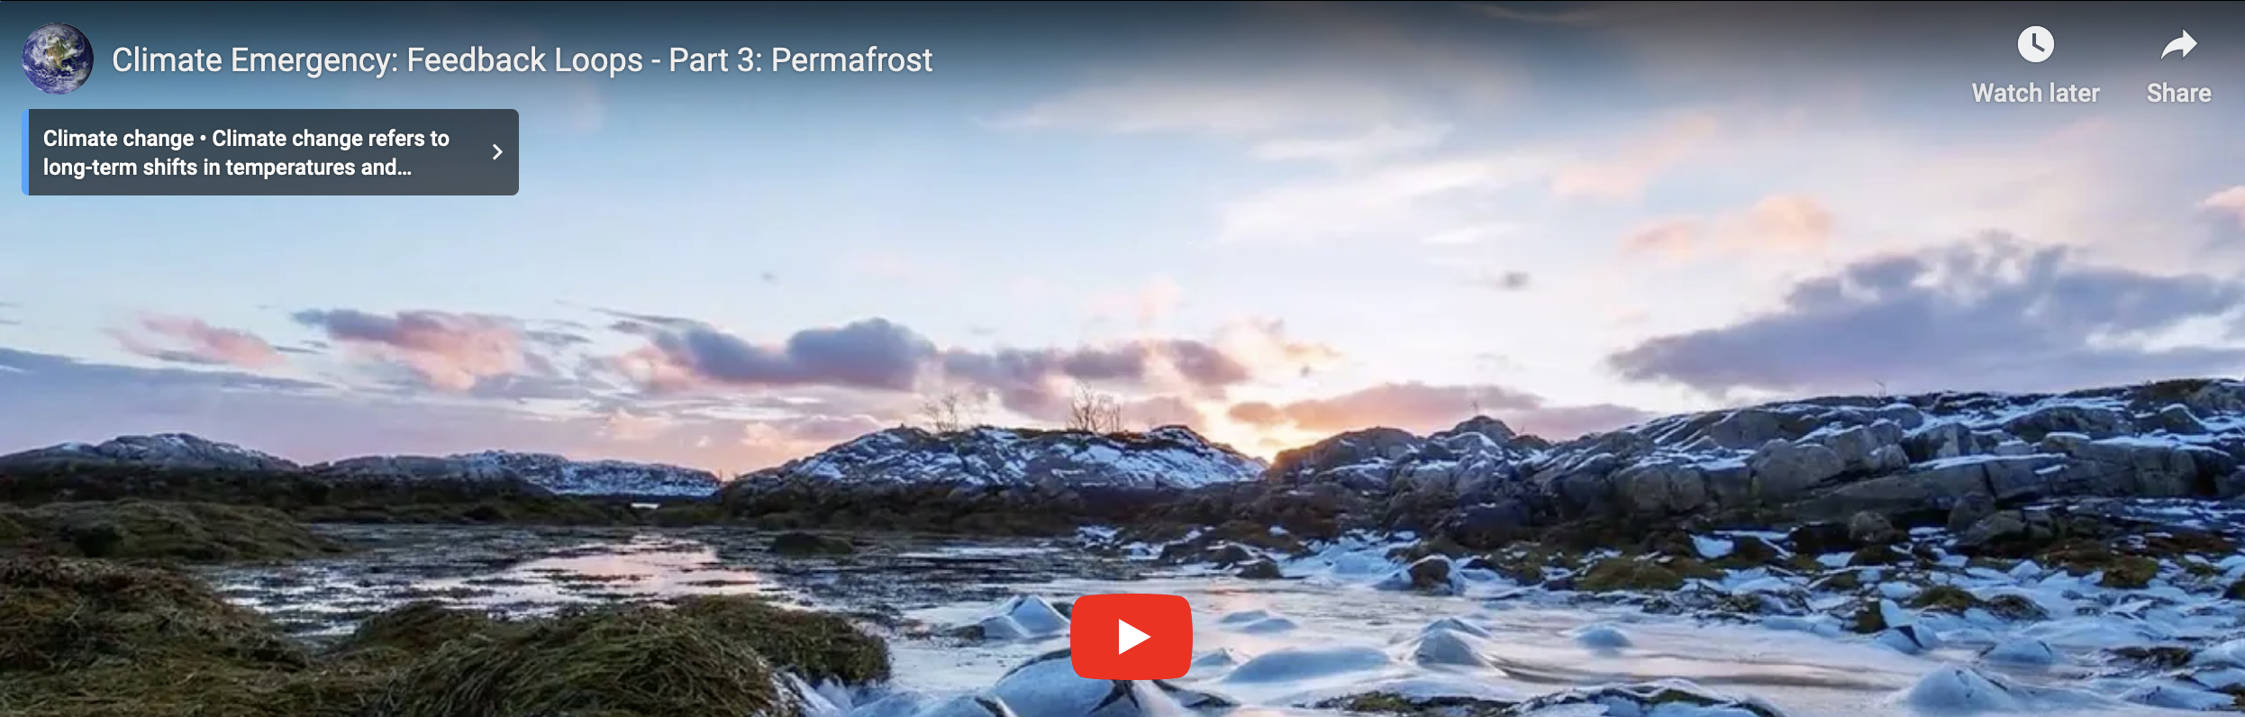
Terrestrial feedback loops

Slide 3
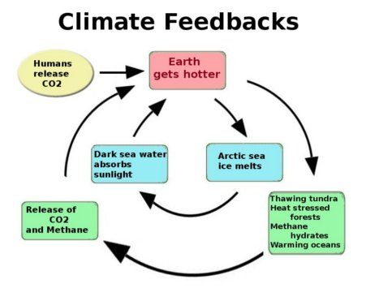
Level 2 feedback
Level 2 has to do with the reduction in CO₂ fertilization (reduced photosynthesis) as the planet warms.
Level 3
Level 2
Concentration CO₂ in the atmosphere (C_atm) goes up
Flux of CO₂ from water to air (F_oa) goes up
Level 1

Slide 4
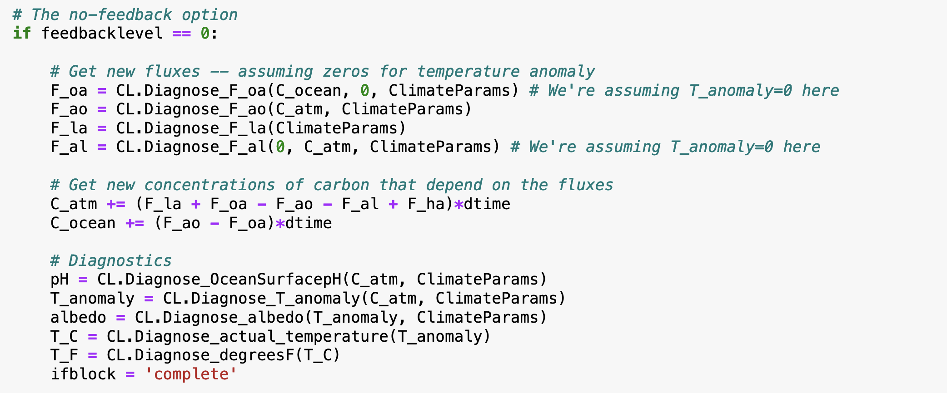
Level 2 feedback ideas
You’ll need to move the calculation of T_anomaly up, in order to pass it to CL.Diagnose_F_al (in addition to CL.Diagnose_F_o).
Don’t forget to increase fbl to 2 in the Euler loop to activate this feedback.

Slide 5
Level 3 feedback
Level 3 has to do with the additional warming due to reduction in Earth’s albedo.
Level 3
Level 2
Concentration CO₂ in the atmosphere (C_atm) goes up
Flux of CO₂ from water to air (F_oa) goes up
Level 1

Slide 6
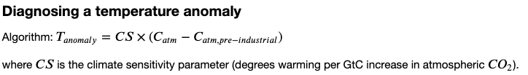
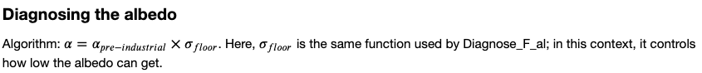
Level 3 feedback ideas
…
…

Slide 7
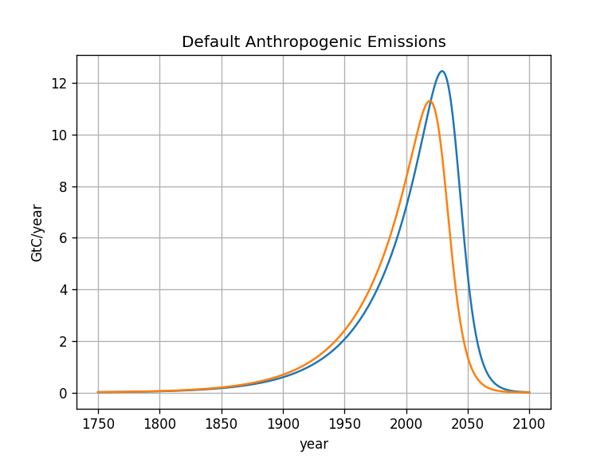
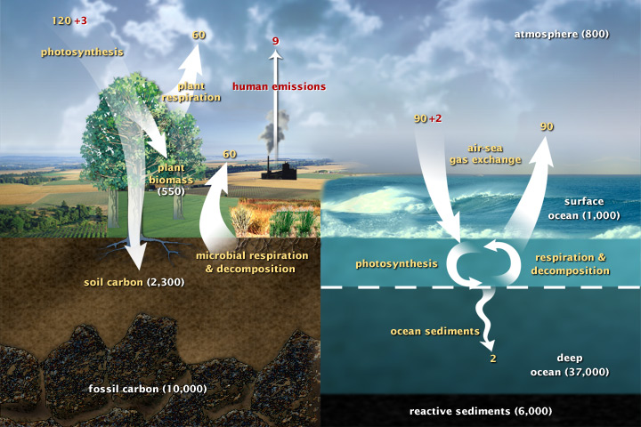
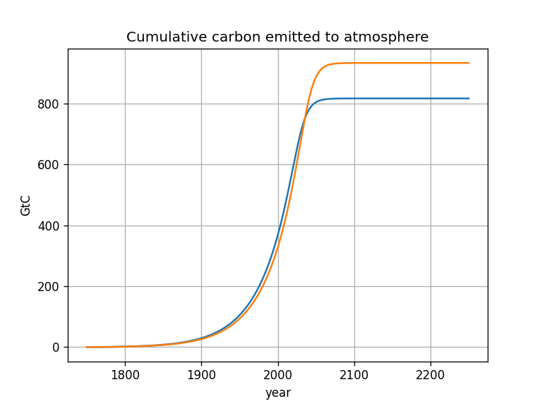
More project ideas: How long can we delay peak emissions (and still stay under $2℃$)

Slide 8
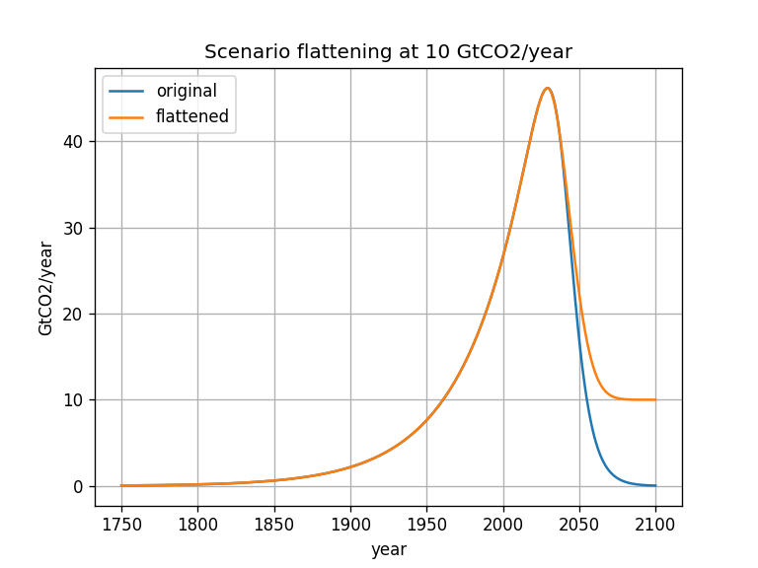
More project ideas: How much decarbonization is necessary (and still stay under $2℃$)?

Slide 9
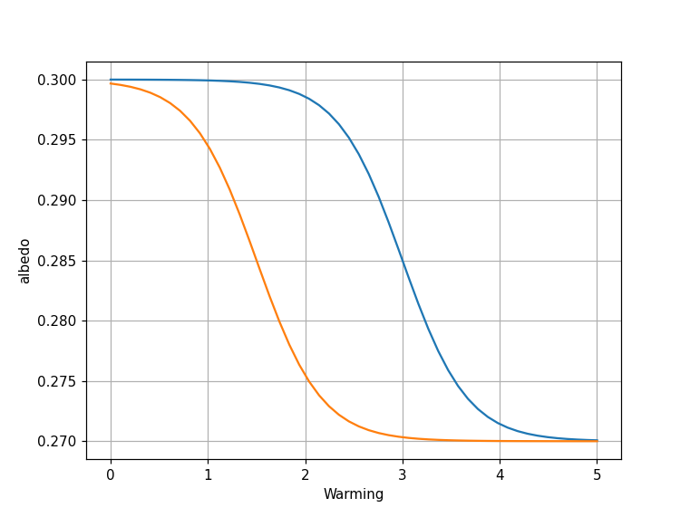
More project ideas: What if the albedo tipping point happens at a lower temperature?

Slide 10
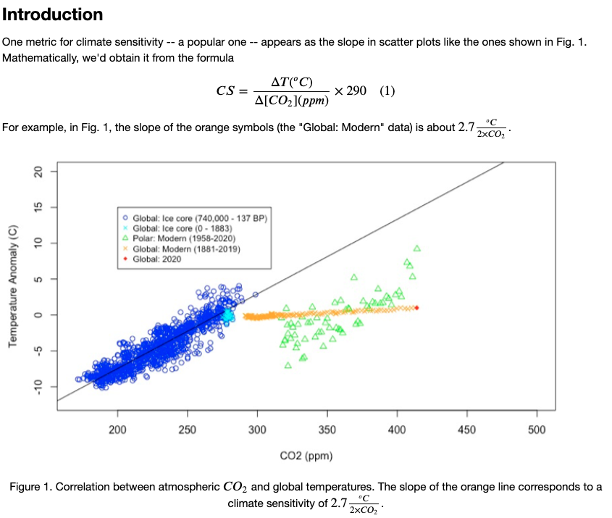
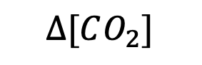

Climate sensitivity and the historical record
$$∆T$$
$$∆[CO_{2}]$$

Slide 11
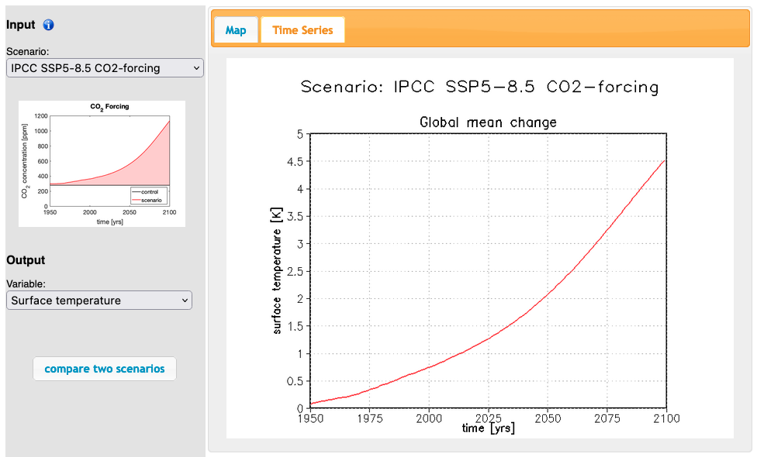
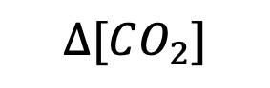

Climate sensitivity and Monash
$$∆[CO_{2}]$$
$$∆T$$

